Slide 1
Precalculus
Algebra
Numbers
Inequalities
Absolute values
Coordinate Geometry
Lines
Trigonometry

Slide 2
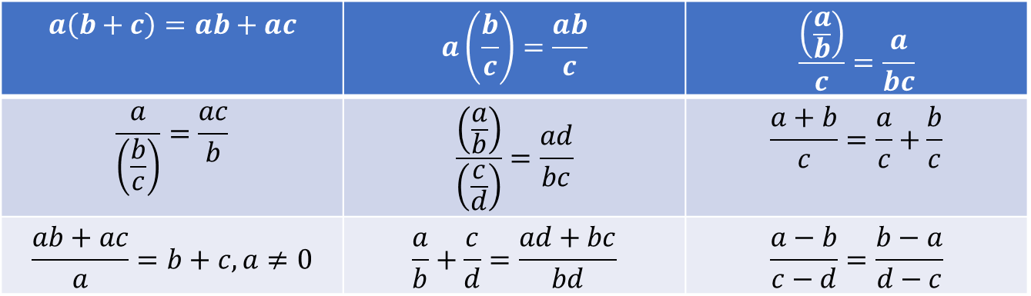
Algebra
Basic properties
Arithmetic Operations
$$a\left(b+c\right)=ab+ac$$ | $$a\left(\frac{b}{c}\right)=\frac{ab}{c}$$ | $$\frac{\left(\frac{a}{b}\right)}{c}=\frac{a}{bc}$$
$$\frac{a}{\left(\frac{b}{c}\right)}=\frac{ac}{b}$$ | $$\frac{\left(\frac{a}{b}\right)}{\left(\frac{c}{d}\right)}=\frac{ad}{bc}$$ | $$\frac{a+b}{c}=\frac{a}{c}+\frac{b}{c}$$
$$\frac{ab+ac}{a}=b+c, a≠0$$ | $$\frac{a}{b}+\frac{c}{d}=\frac{ad+bc}{bd}$$ | $$\frac{a−b}{c−d}=\frac{b−a}{d−c}$$

Slide 3
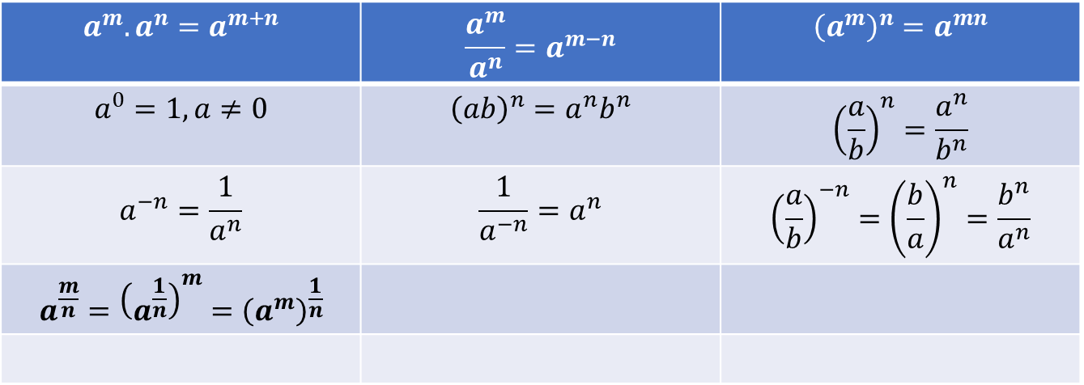
Algebra
Basic properties
Exponent properties
$$a^{m}.a^{n}=a^{m+n}$$ | $$\frac{a^{m}}{a^{n}}=a^{m−n}$$ | $${\left(a^{m}\right)}^{n}=a^{mn}$$
$$a^{0}=1, a≠0$$ | $${\left(ab\right)}^{n}=a^{n}b^{n}$$ | $${\left(\frac{a}{b}\right)}^{n}=\frac{a^{n}}{b^{n}}$$
$$a^{−n}=\frac{1}{a^{n}}$$ | $$\frac{1}{a^{−n}}=a^{n}$$ | $${\left(\frac{a}{b}\right)}^{−n}={\left(\frac{b}{a}\right)}^{n}=\frac{b^{n}}{a^{n}}$$
$$a^{\frac{m}{n}}={\left(a^{\frac{1}{n}}\right)}^{m}={\left(a^{m}\right)}^{\frac{1}{n}}$$

Slide 4
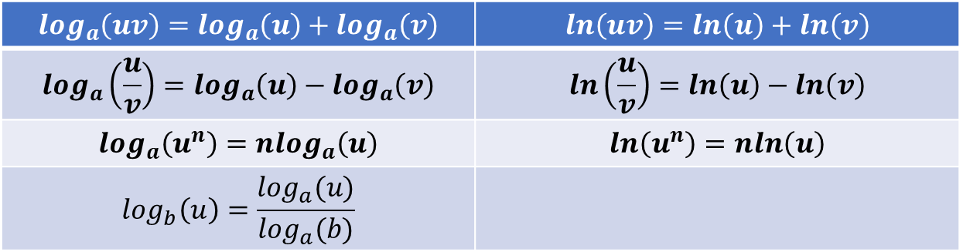
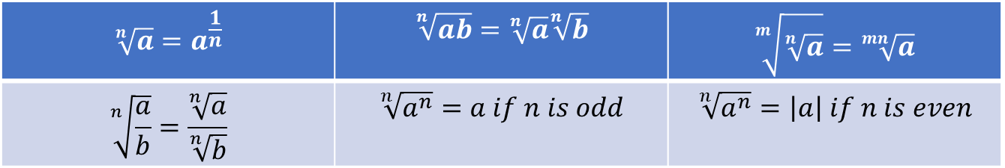
Algebra
Basic properties
Properties of Radicals
Logarithmic properties
$$\sqrt[n]{a}=a^{\frac{1}{n}}$$ | $$\sqrt[n]{ab}=\sqrt[n]{a}\sqrt[n]{b}$$ | $$\sqrt[m]{\sqrt[n]{a}}=\sqrt[mn]{a}$$
$$\sqrt[n]{\frac{a}{b}}=\frac{\sqrt[n]{a}}{\sqrt[n]{b}}$$ | $$\sqrt[n]{a^{n}}=a if n is odd$$ | $$\sqrt[n]{a^{n}}=\left|a\right| if n is even$$
$$\log_{a}\left(uv\right)=\log_{a}\left(u\right)+\log_{a}\left(v\right)$$ | $$ln\left(uv\right)=ln\left(u\right)+ln\left(v\right)$$
$$\log_{a}\left(\frac{u}{v}\right)=\log_{a}\left(u\right)−\log_{a}\left(v\right)$$ | $$ln\left(\frac{u}{v}\right)=ln\left(u\right)−ln\left(v\right)$$
$$\log_{a}\left(u^{n}\right)=n\log_{a}\left(u\right)$$ | $$ln\left(u^{n}\right)=nln\left(u\right)$$
$$\log_{b}\left(u\right)=\frac{\log_{a}(u)}{\log_{a}(b)}$$
Diagnostic test
A – Algebra Q. 1 –10,
C – Functions Q. 1 – 7

Slide 5

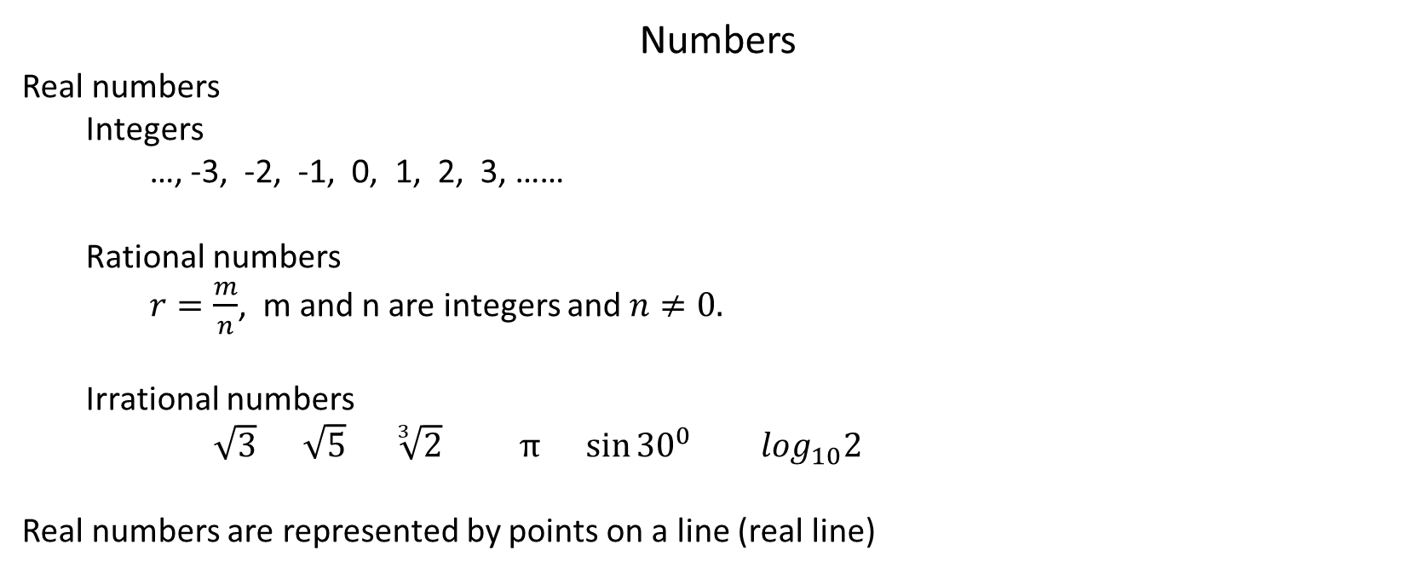

Numbers
Real numbers
Integers
…, -3, -2, -1, 0, 1, 2, 3, ……
Rational numbers
$r=\frac{m}{n}$, m and n are integers and $n≠0.$
Irrational numbers
$\sqrt{3} \sqrt{5}$ $\sqrt[3]{2} π \sin{{30}^{0}} \log_{10}2$
Real numbers are represented by points on a line (real line)
-2.63
-3/7
½
$$√2$$
$$π$$
-3
-2
-1
0
1
2
3
4
(P# A2)

Slide 6

Intervals
Open Interval
$$\left(a, b\right)=\left\{x | a<x<b\right\}$$
Closed Interval
$$\left[a, b\right]=\left\{x | a≤x≤b\right\}$$
Infinite Interval
$$\left(a, ∞\right)=\left\{x | x>a\right\}$$
$$\left(−∞, a\right)=\left\{x | x<a\right\}$$
$$\left(−∞, ∞\right) set of all real numbers$$
(P# A3)

Slide 7
Inequalities
Rules of inequalities
1. If a<b, then a+c < b+c
2. If a < b and c < d, then a+c < b+d
3. If a < b and c > 0, then ac < bc
4. If a < b and c < 0, then ac > bc
5. If 0 < a < b, then 1/a > 1/b
(P# A4) Ex-1—4

Slide 8
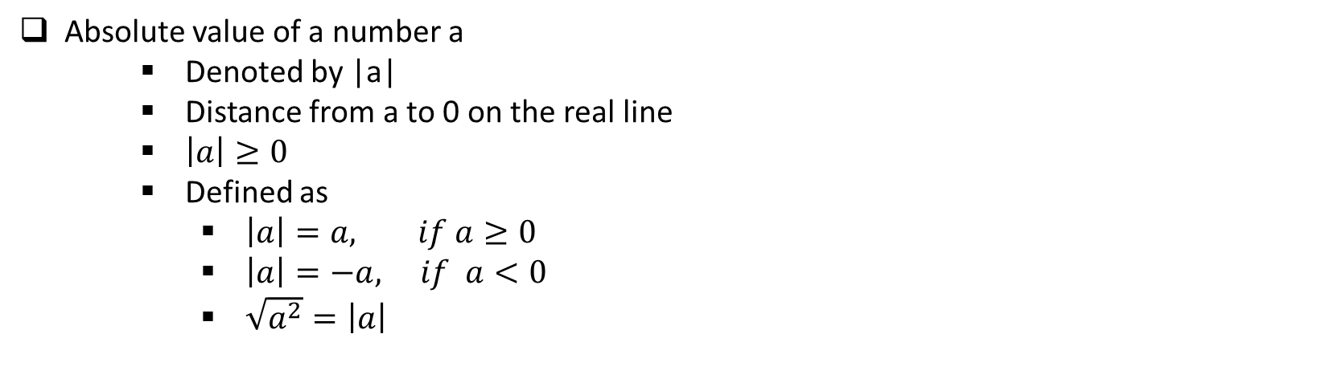
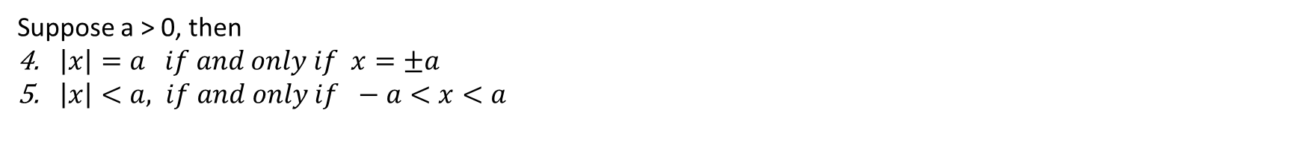
Absolute value
Absolute value of a number a
Denoted by |a|
Distance from a to 0 on the real line
$\left|a\right|≥0$
Defined as
$\left|a\right|=a, if a≥0$
$\left|a\right|=−a, if a<0$
$\sqrt{a^{2}}=\left|a\right|$
Properties
1. $\left|ab\right|=\left|a\right|\left|b\right| 2. \left|\frac{a}{b}\right|=\frac{\left|a\right|}{\left|b\right|} \left(b≠0\right) 3. \left|a^{n}\right|={\left|a\right|}^{n}$
Suppose a > 0, then
$\left|x\right|=a if and only if x=±a$
$\left|x\right|<a, if and only if −a<x<a$
6. $\left|x\right|>a, if and only if x>a or x<−a$
(P# A6) Ex- 5—8

Slide 9
Corodinate Geometry
y
(-1,2)
(1,2)
II
I
x
(-1,-2)
(1,-2)
III
IV
The coordinate system is called
Rectangular coordinate system or Cartesian coordinate system
Exercise: Describe and sketch the regions given by the following sets
$\left\{(x, y) | x≥0\right\}$ (b) $\left\{(x, y) | y=1\right\}$ (c) $\left\{(x, y) | \left|y\right|<1\right\}$
Distance: The distance between two points $P_{1}\left(x_{1}, y_{1}\right) and P_{2}(x_{2}, y_{2})$ is
$\left|P_{1}P_{2}\right|=\sqrt{{\left(x_{2}−x_{1}\right)}^{2}+{\left(y_{2}−y_{1}\right)}^{2}}$

Slide 10
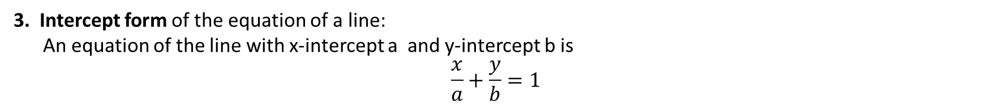
Straight Lines
Slope of a nonvertical line that passes through the points $P_{1}\left(x_{1}, y_{1}\right) and P_{2}(x_{2}, y_{2})$ is
$$m=\frac{y_{2}−y_{1}}{x_{2}−x_{1}}$$
Point-Slope form of the equation of a line:
An equation of the line passing through the point $P_{1}\left(x_{1}, y_{1}\right) and having slope m is$
$$y−y_{1}=m(x−x_{1})$$
2. Slope-Intercept form of the equation of a line:
An equation of the line with slope m and y-intercept b is
$$y=mx+b$$
3. Intercept form of the equation of a line:
An equation of the line with x-intercept a and y-intercept b is
$$\frac{x}{a}+\frac{y}{b}=1$$

Slide 11
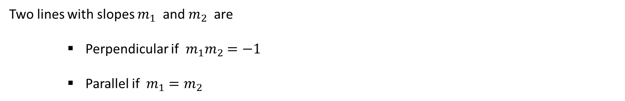
Parallel and Perpendicular lines
Two lines with slopes $m_{1}$ and $m_{2}$ are
Perpendicular if $m_{1}m_{2}=−1$
Parallel if $m_{1}=m_{2}$
P# A10
Lines P# A12 Ex- 1 – 8,
B – Analytic Geometry Q. 1 – 5

Slide 12

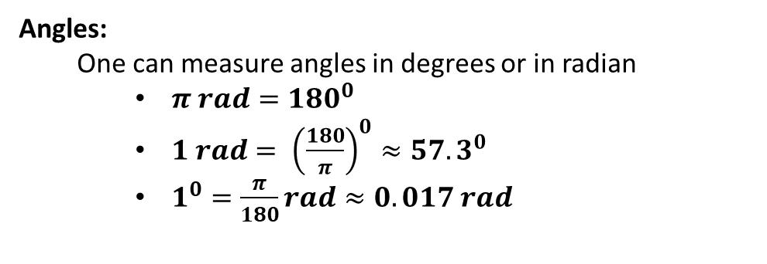
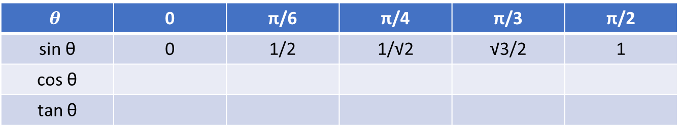
Trigonometry
Angles:
One can measure angles in degrees or in radian
$π rad={180}^{0}$
$1 rad= {\left(\frac{180}{π}\right)}^{0}≈57.3^{0}$
$1^{0}=\frac{π}{180}rad≈0.017 rad$
a
The relation between arc length and radius
$$a=rθ$$
r
θ
r
Table showing some values of $\sin{θ,\cos{θ and\tan{θ}}}$
$$θ$$ | 0 | π/6 | π/4 | π/3 | π/2
sin θ | 0 | 1/2 | 1/√2 | √3/2 | 1
cos θ
tan θ

Slide 13
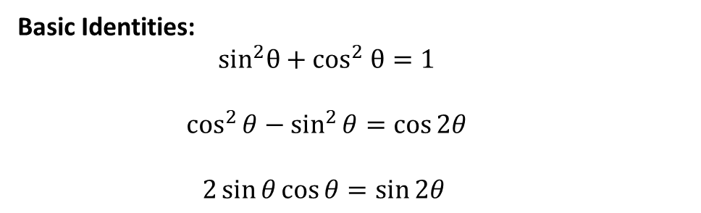
Trigonometry
Basic Identities:
$$sin^{2}θ+cos^{2} θ=1$$
$$\cos^{2}{θ−\sin^{2}{θ}}=\cos{2θ}$$
$$2\sin{θ\cos{θ=\sin{2θ} }}$$
Trigonometric Identities (P# A28),
D – Trigonometry Q. 1 – 9

